Slide 1
Business Intelligence Fundamentals
Week 6: Mathematical Models

Slide 2
Example – Determine Missing Values
Suppose we have sales data for each year from 2010 through 2015 with the exception of 2013. Can we reasonably estimate what the sales for 2013 were?
Year | Sales ($)
2010 | 10,000
2011 | 15,000
2012 | 20,000
2013 | ?
2014 | 30,000
2015 | 35,000

Slide 3
Example – Determine Future Values
Suppose we track the number of unique visitors to a website and that we have data for each year from 2012 through 2016. Can we reasonably predict the number of unique visitors for 2017?
Year | Unique Visitors
2012 | 300
2013 | 400
2014 | 500
2015 | 600
2016 | 700
2017 | ?

Slide 4
Mathematical Model
A description of interacting or independent parts of a “whole” using mathematical concepts and language
Can be descriptive, predictive, or prescriptive
Though models can be very complex, many tools exist to create and work with them
Seven Bridges of Königsberg
By Bogdan Giuşcă - Public domain (PD), based on the image, CC BY-SA 3.0, https://commons.wikimedia.org/w/index.php?curid=112920
CC BY-SA 3.0, https://commons.wikimedia.org/w/index.php?curid=851840

Slide 5
Mathematical Models
Sales = 500 * (Year – 2010) + 10000
Visitors = 100 * (Year – 2012) + 300

Slide 6
Regression
Statistical process for estimating relationship between one or more independent variables and a dependent variable
Can be use for both interpolation and extrapolation
Extrapolated values often accompanied by indication of uncertainty
We’ll look at two types: linear and logistic
By Sewaqu - Own work, Public Domain, https://commons.wikimedia.org/w/index.php?curid=11967659

Slide 7
Linear Regression
Attempts to model the relationship between independent variables and the dependent variable in the form of a line
Ordinary least squares, a common type of linear regression, attempts to minimize difference (green line) between observed values (red dots) and values on the regression line (blue line)
By Oleg Alexandrov - self-made with MATLAB, Public Domain, https://commons.wikimedia.org/w/index.php?curid=4099808

Slide 8
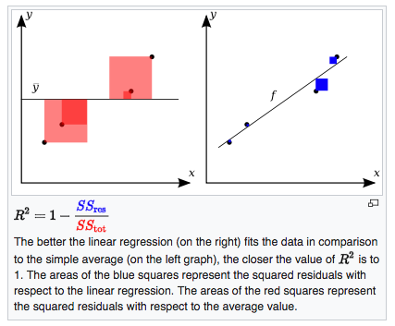
Linear Regression
Typically, the coefficients of a linear equation are calculated: y = B₀ + B₁X where B₀ is the intercept and B₁ is the slope of the line.
Coefficient of determination, R², is a measure of how well the regression fits the data
https://en.wikipedia.org/wiki/Coefficient_of_determination
By Orzetto - Own work, CC BY-SA 3.0, https://commons.wikimedia.org/w/index.php?curid=11398293

Slide 9
Linear Regression - Anscombe’s quartet
Property | Value
Mean of x | 9
Variance of x | 11
Mean of y | 7.50
Variance of y | 4.124
Correlation | 0.816
Linear Regression Line | y = 3.00 + 0.500x
Coefficient of Determination | 0.67
By Anscombe.svg: SchutzDerivative works of this file:(label using subscripts): Avenue - Anscombe.svg, CC BY-SA 3.0, https://commons.wikimedia.org/w/index.php?curid=9838454

Slide 10
Lab – Part I

Slide 11
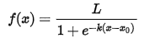
Logistic Regression
Regression in which the dependent variable is categorical
Simplest case covers binary dependent variables
Examples: pass/fail, win/lose, alive/dead
Methods exist when more than two outcomes are possible
Assumes data can be modeled with a logistic function
Often divide observation data into training and testing sets
By Qef (talk) - Created from scratch with gnuplot, Public Domain, https://commons.wikimedia.org/w/index.php?curid=4310325

Slide 12
Lab - Part II

Slide 13
Exercise

